Slide 1

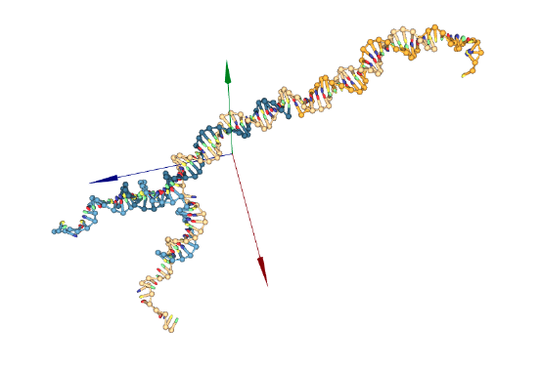
First steps on oxDNA
Trainne: Alejandro Soto
Supervisor: Dr. Iliya D. Stoev

Slide 2
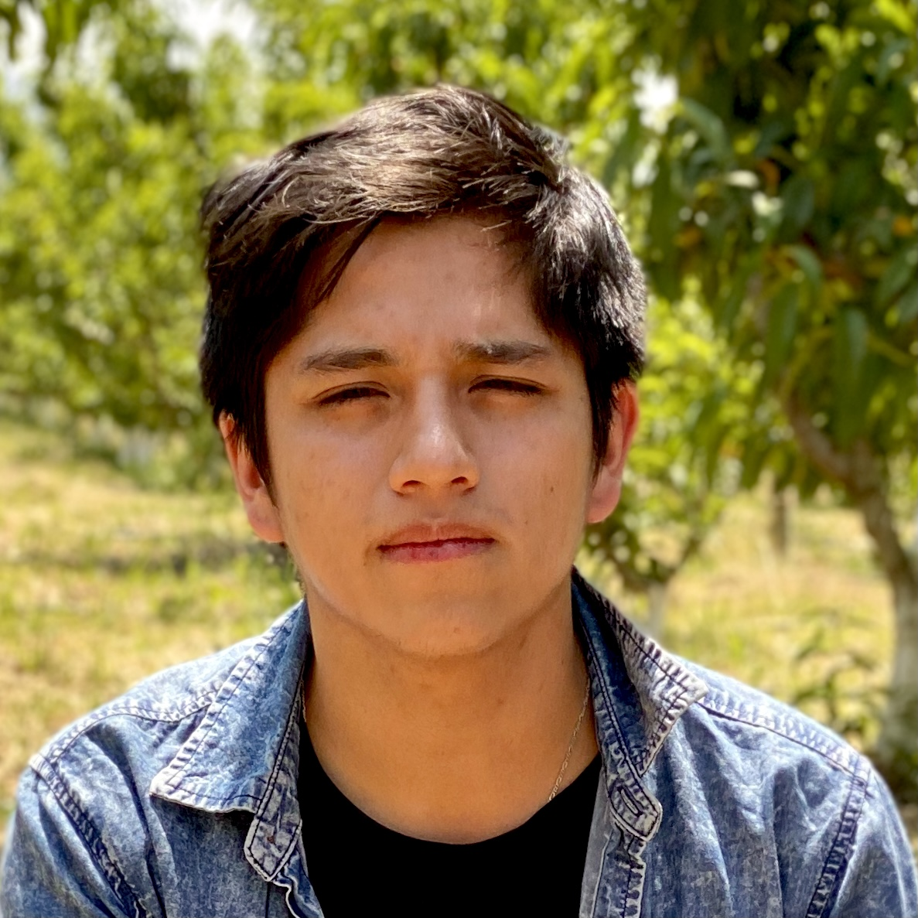
About me
Experiences:
Swiss Federal Laboratories for Materials Science and Technology:
Research and Development of new biobased materials for thermal insulation.
SENAI – ISI (SENAI of Innovation in Advanced Materials):
Characterization of polymers using techniques such as XRF, XRD, SEM, and Rheology (CSR, SAOS, Capillary).
CUIE (Energy Research Center, UMSS):
Conducted Big Data Analysis, Linear programming, and stochastic modeling using Python.

Slide 3
First steps: Reviewing
Relevant papers for the work:
Xing, Z., Caciagli, A., Cao, T., Stoev, I., Zupkauskas, M., O’Neill, T., ... & Eiser, E. (2018). Microrheology of DNA hydrogels. Proceedings of the National Academy of Sciences, 115(32), 8137-8142.
Stoev, I. D., Cao, T., Caciagli, A., Yu, J., Ness, C., Liu, R., ... & Eiser, E. (2020). On the role of flexibility in linker-mediated DNA hydrogels. Soft Matter, 16(4), 990-1001.
Stoev, Iliya D., et al. "Using single-beam optical tweezers for the passive microrheology of complex fluids." Optical Trapping and Optical Micromanipulation XV. Vol. 10723. SPIE, 2018.
Stoev, I. D., Caciagli, A., Mukhopadhyay, A., Ness, C., & Eiser, E. (2021). Bulk rheology of sticky DNA-functionalized emulsions. Physical Review E, 104(5), 054602.
Mukhopadhyay, A., Stoev, I. D., King, D. A., Sharma, K. P., & Eiser, E. (2022). Amyloid-Like Aggregation in Native Protein and its Suppression in the Bio-Conjugated Counterpart. Frontiers in Physics, 10, 924864.
Stoev, I. (2021). Broadband Rheological Characterisation of Soft Functional Materials (Doctoral dissertation).

Slide 4
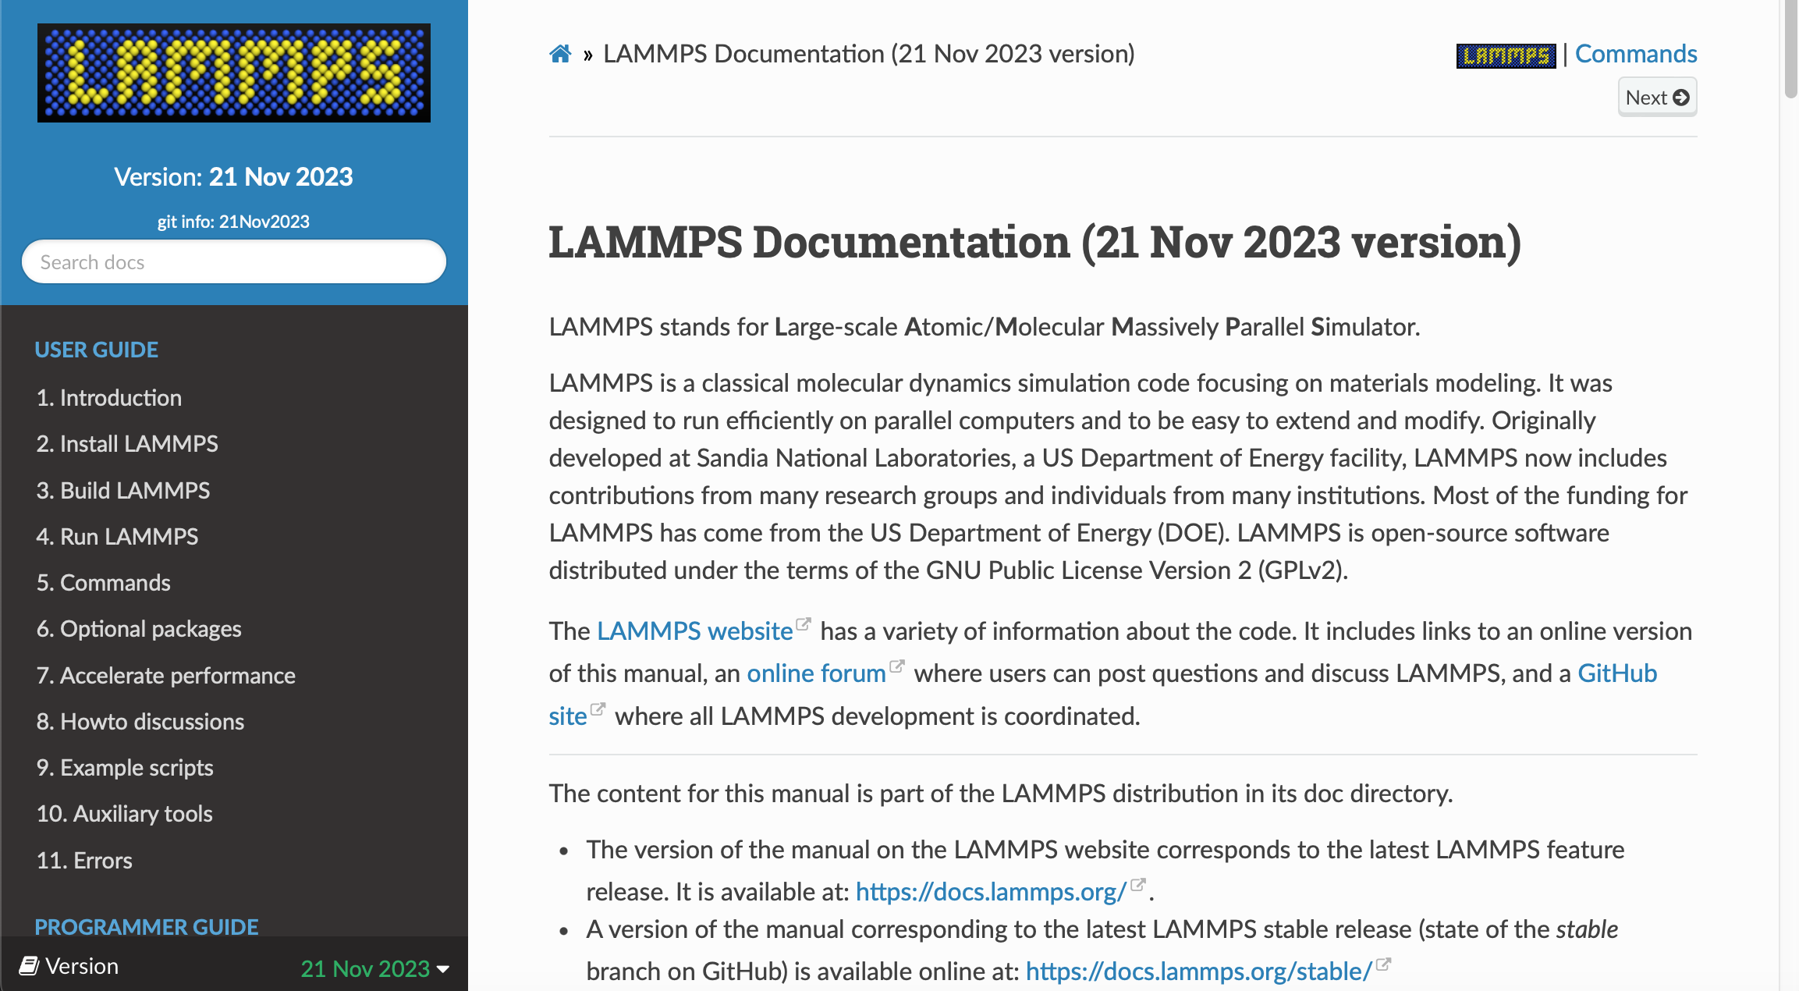
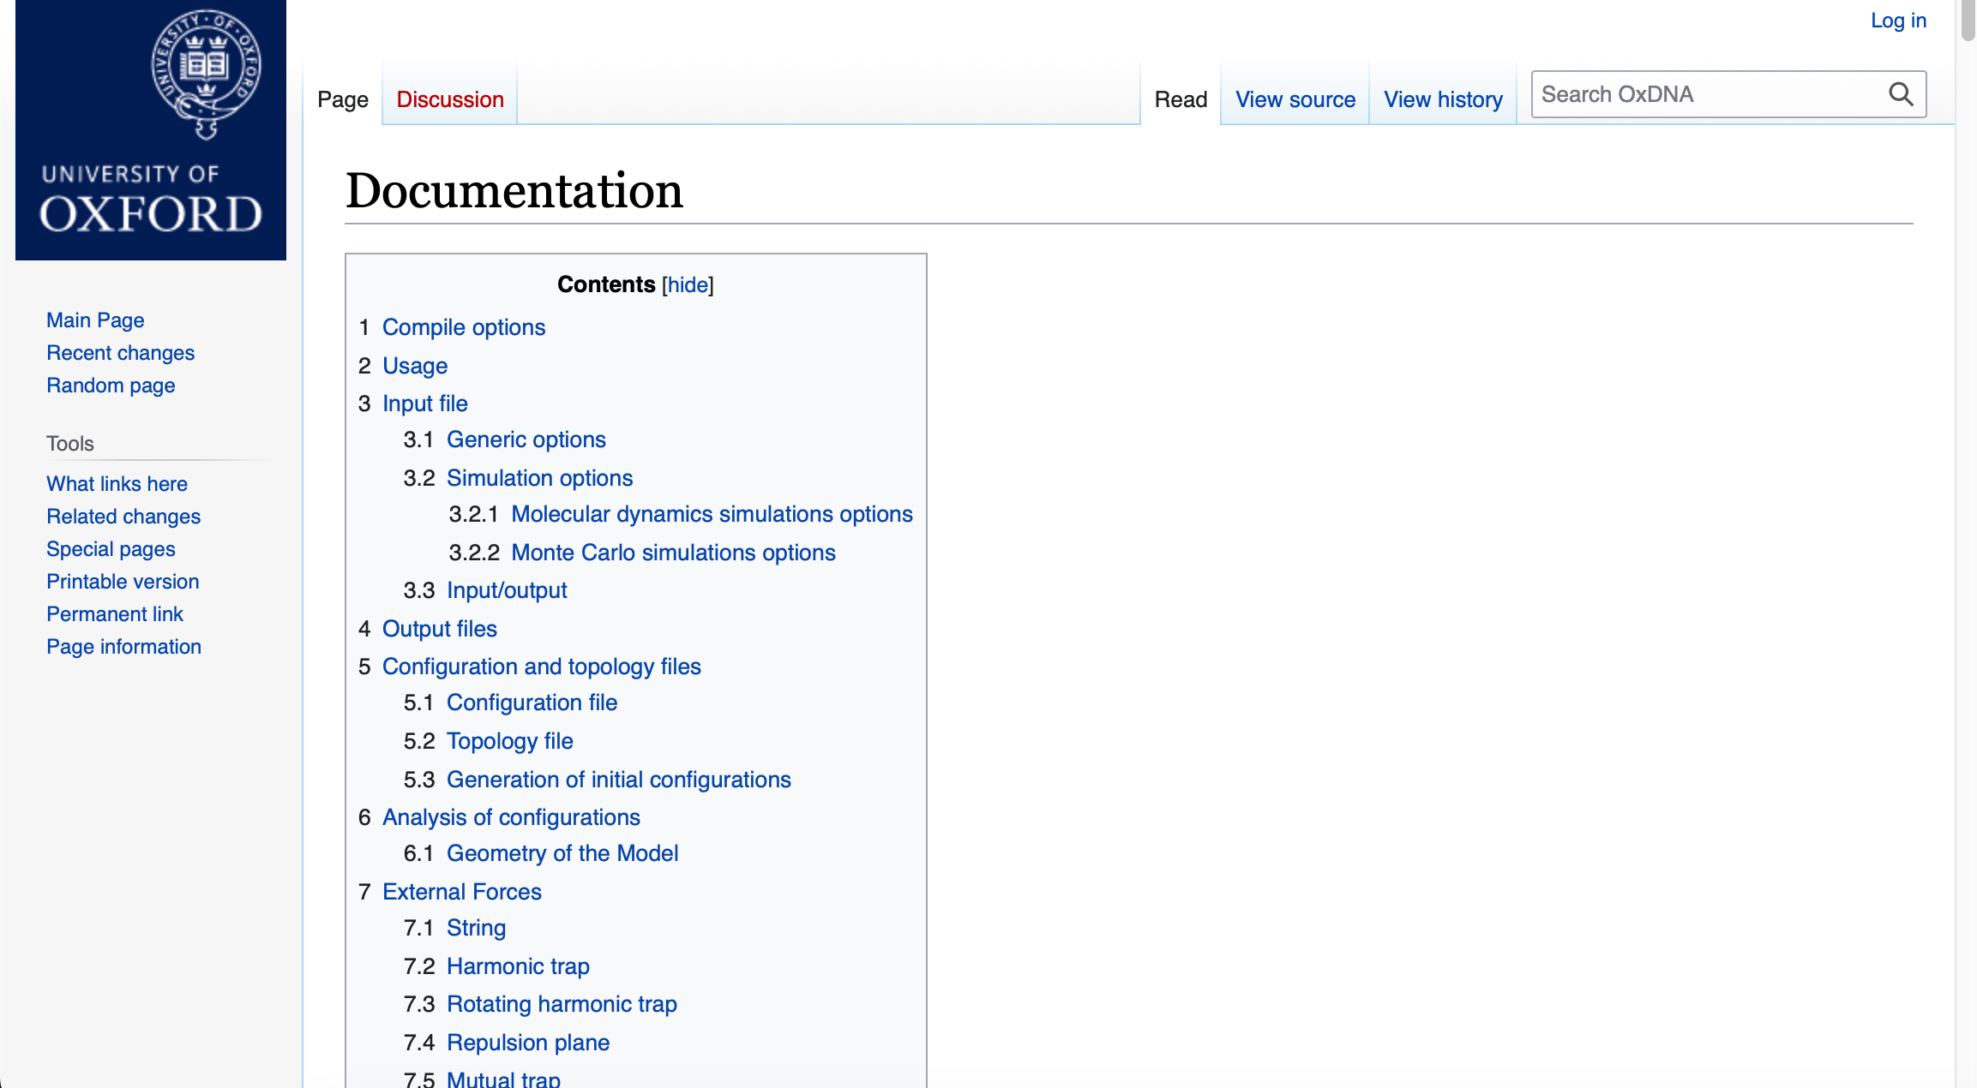
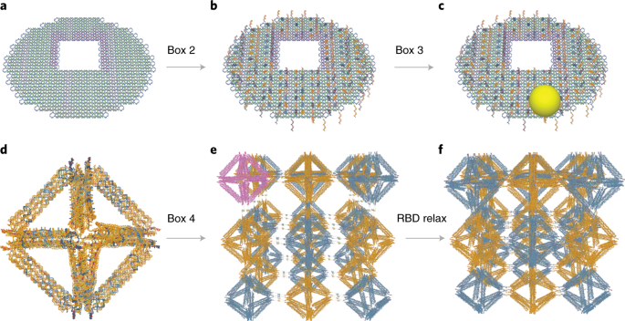
First steps: Installation and visualization
oxDNA, LAMMPS, oxView

Slide 5
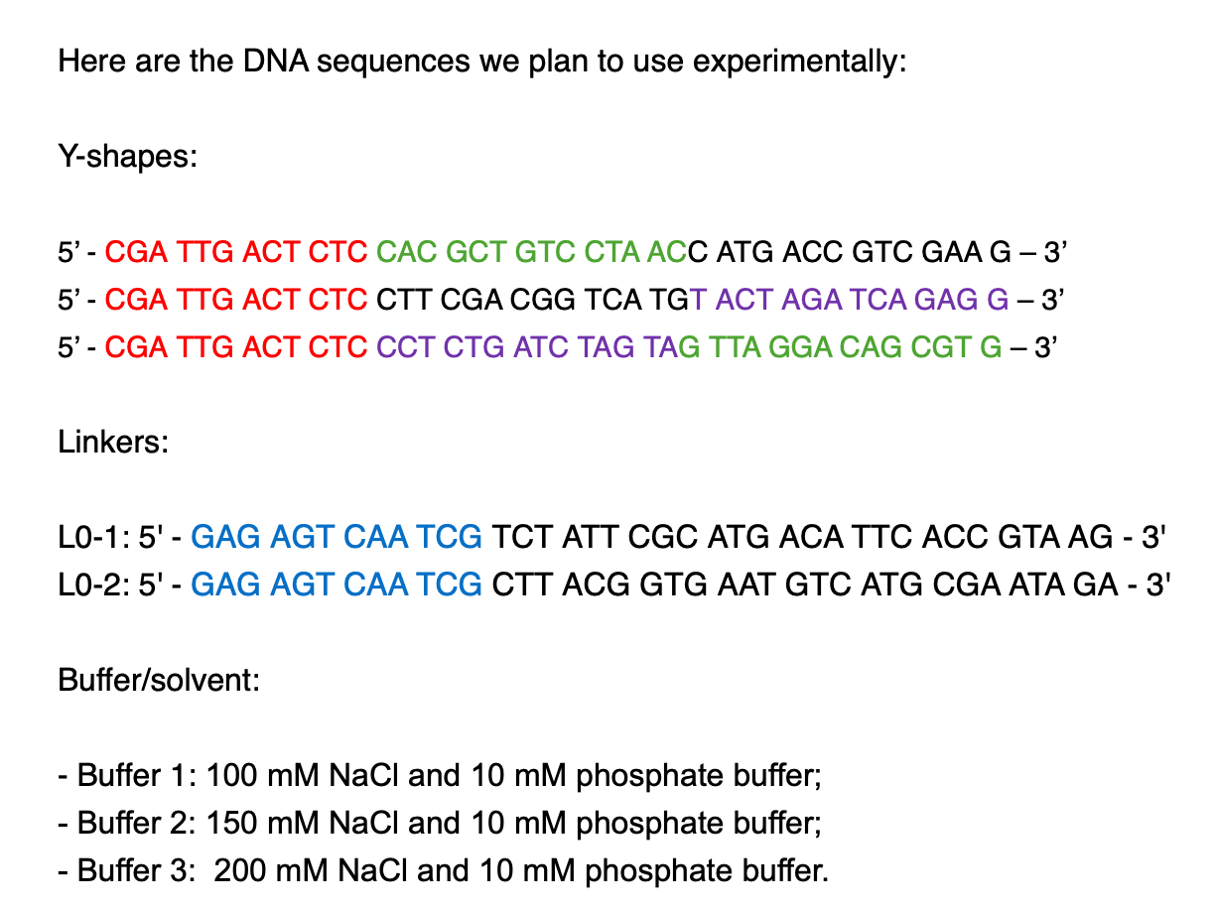

First task: Trimer
Given sequence:

Slide 6
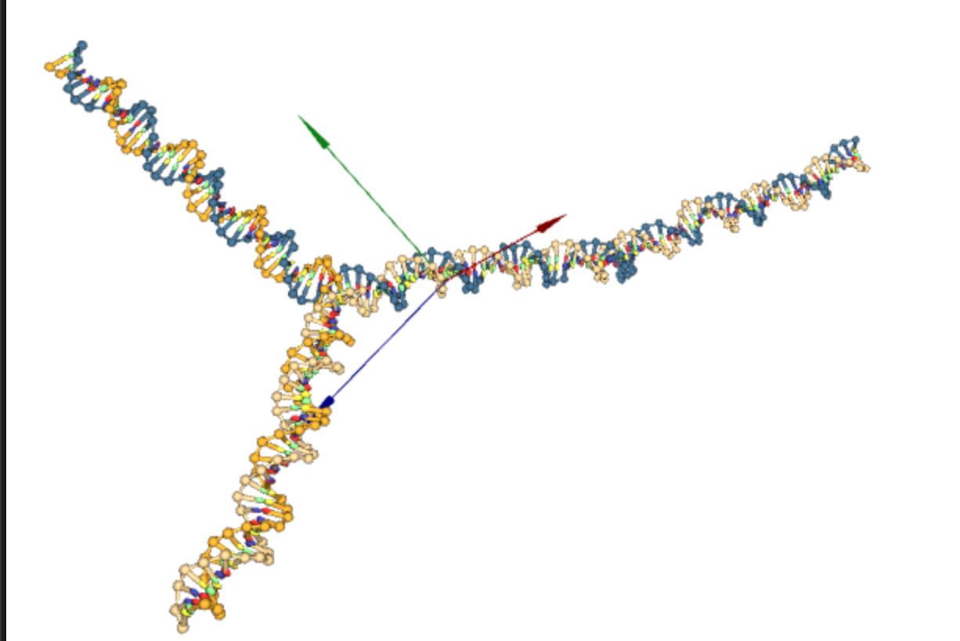
First task: Trimer
Misunderstanding:
Symmetric Y-shape. Joined the strands at the end and beginning. (Duplex)
S1+L1+S2+L2+S3
L1
Figure 1. Y-shape (symmetric) + Linker 1

Slide 7
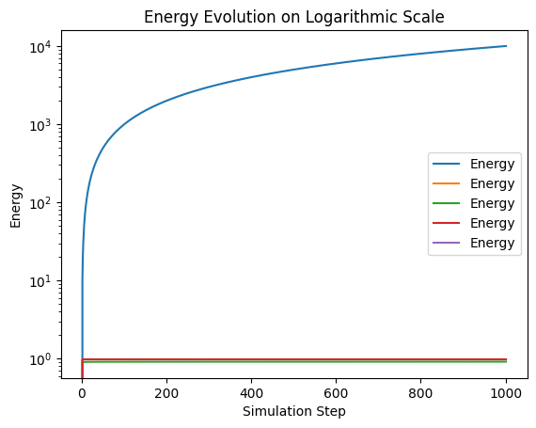
First task: Trimer
Methodology:
Inserted the sequence (duplex).
Copied three times.
Joined (using the ligate feature).
Enabled Rigid body. (set the variables)
Ran MC.
Ran oxDNA to obtain the energy plot.
Figure 3. Energy plot of Y-shape (symmetric)
Figure 1. Y-shape (symmetric) + Linker 1

Slide 8
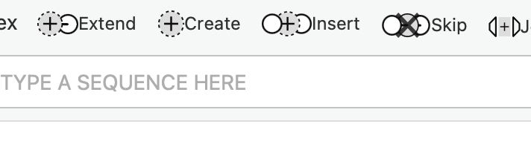
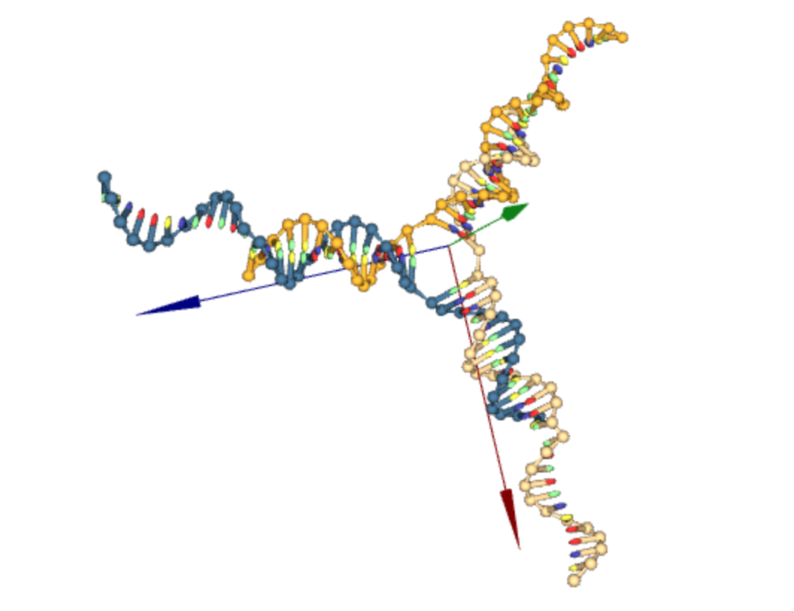
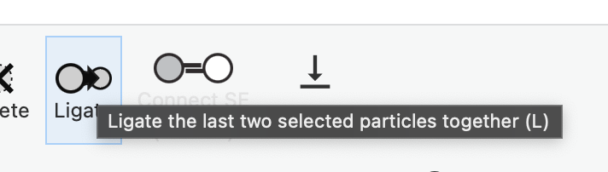
Second task: Relax Y-shape DNA
Methodology:
Inserted the sequence (one by one). OK
Joined by the parts that allows the bound of the duplex and sticky ends. OK
Joined (using the ligate feature). I kept this just to join the duplex part of the Y shape, then I used the ”Expand feature”.
Enabled Rigid body. SOMETIMES! (just for the duplex parts joined), I used the relaxation simulation on oxDNA (backbone and forces files)
Ran MC. And MD to get time dependance.
Ran oxDNA to obtain the energy plot. Not anymore.
Figure 2. Building Y-shape

Slide 9
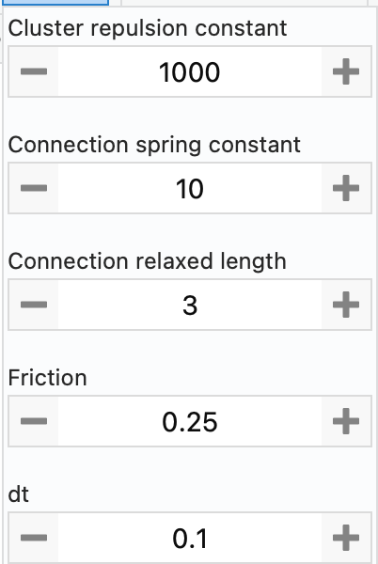
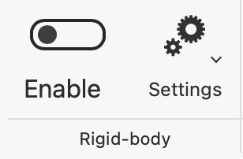
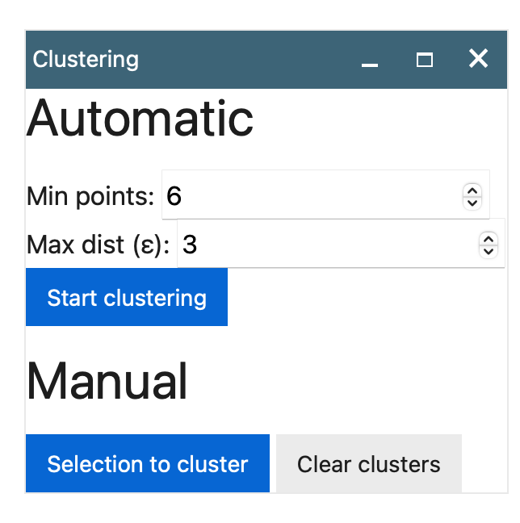
Second task: Relax Y-shape DNA
Methodology:
Inserted the sequence (one by one). OK
Joined by the parts that allows the bound of the duplex and sticky ends. OK
Joined (using the ligate feature). I kept this just to join the duplex part of the Y shape, then I used the ”Extend feature”.
Enabled Rigid body. SOMETIMES! (just for the duplex parts joined), I used the relaxation simulation on oxDNA (backbone and forces files)
Ran MC. And MD to get time dependance.
Ran oxDNA to obtain the energy plot. Not anymore.
Method DBSCAN
Depends on the density, and other variables, distances, etc
Figure 3. RBD (Rigid Body Dynamics) variables

Slide 10
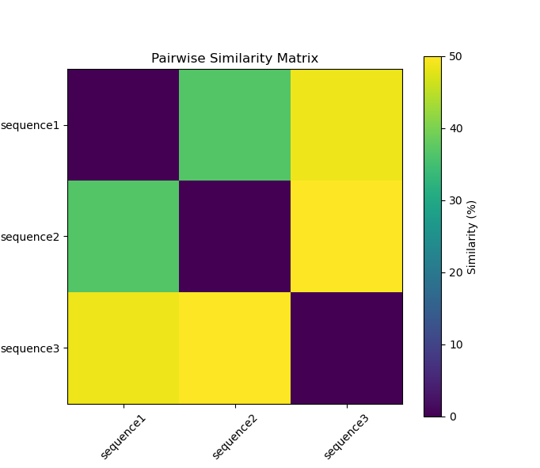
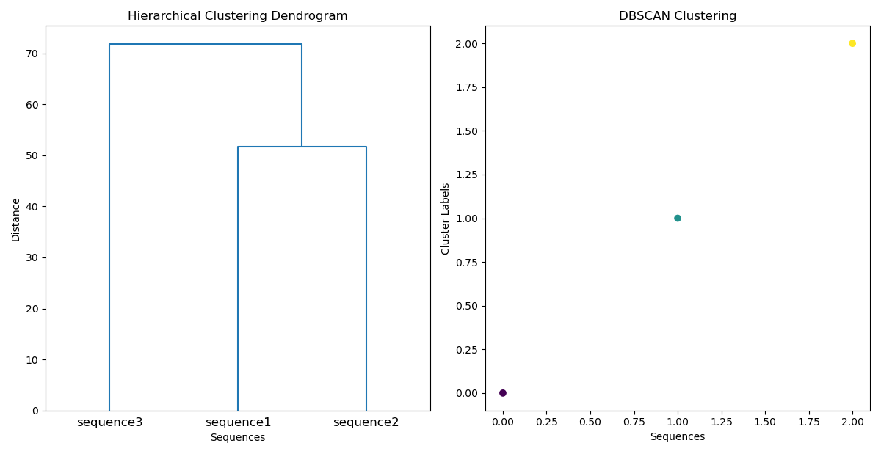
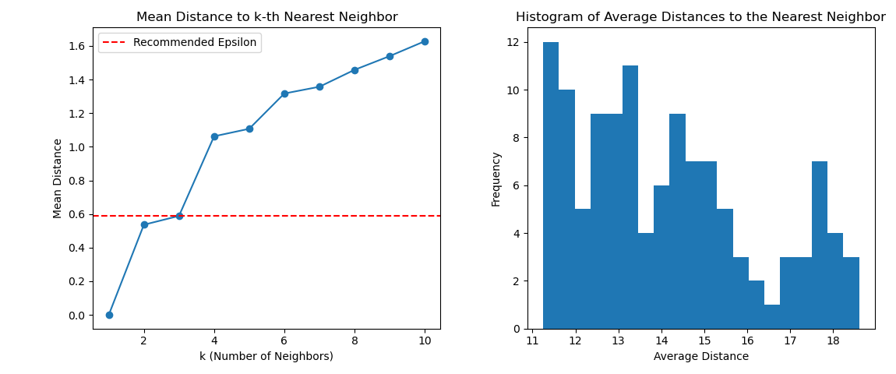
Second task: Relax Y-shape DNA
Methodology:
Inserted the sequence (one by one). OK
Joined by the parts that allows the bound of the duplex and sticky ends. OK
Joined (using the ligate feature). I kept this just to join the duplex part of the Y shape, then I used the ”Extend feature”.
Enabled Rigid body. SOMETIMES! (just for the duplex parts joined), I used the relaxation simulation on oxDNA (backbone and forces files)
Ran MC. And MD to get time dependance.
Ran oxDNA to obtain the energy plot. Not anymore.
Suggested values of epsilon and min point for the automatic clustering
Figure 4. RBD (Rigid Body Dynamics) – Finding out clustering

Slide 11
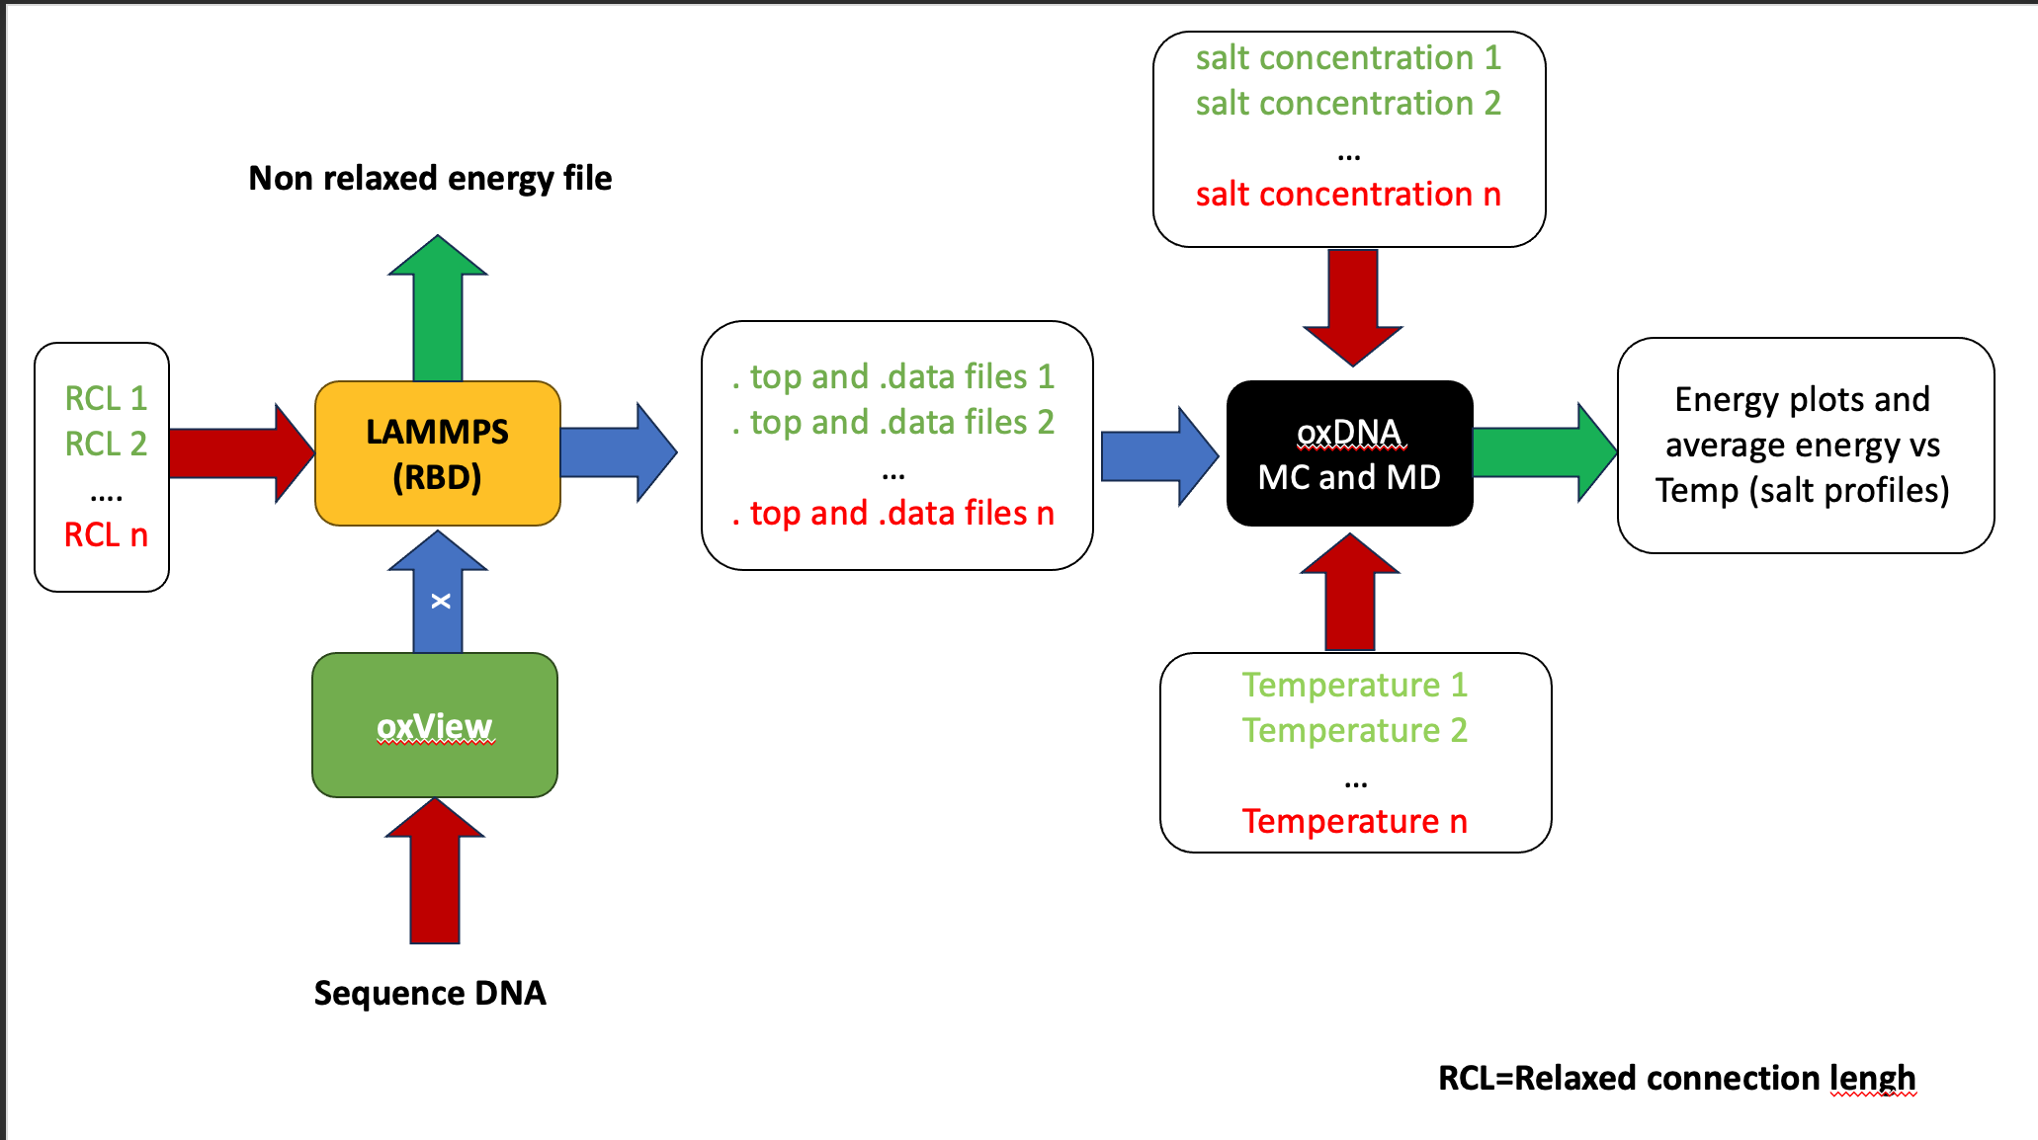

Second task: Relax Y-shape DNA
Methodology:
Inserted the sequence (one by one). OK
Joined by the parts that allows the bound of the duplex and sticky ends. OK
Joined (using the ligate feature). I kept this just to join the duplex part of the Y shape, then I used the ”Extend feature”.
Enabled Rigid body. SOMETIMES! (just for the duplex parts joined), I used the relaxation simulation on oxDNA (backbone and forces files)
AND MAKE THE SCREENING OF THE RELAXED CONNECTION LENGTH
Ran MC. And MD to get time dependance.
Ran oxDNA to obtain the energy plot. Not anymore.
Figure 5. Proposed Methodology for a single Y-shape
SHOULD I JOIN (Y SHAPE – LINKER –Y SHAPE) BEFORE RELAXED AND MAKE THE SCREENING ???

Slide 12
Second task: Relax Y-shape DNA
NEXT STEPS:
Screening of temperatures. (and salt concentration) Agreed the last meeting for a single y-shape CORRECT THE VALUE 0 FOR SALT CONCENTRATION
Screening of the connection relaxed length. (How? RBD? How to change it?) Conclusion use LAMMPS TO MAKE IT AUTOMATIC?
How to reduce the hairpins? Changing the temperature (Range provided 56°C-60°C)
Can I remove temporally the sticky ends? Yes, but tricky
Figure 6. Y-shape

Slide 13
Second task: Relax Y-shape DNA
ALTERNATIVES TO SIMULATE THE RELAXATION:
Using the backbone force and external forces files to keep the duplex strands together.
Figure 6. Y-shape

Slide 14
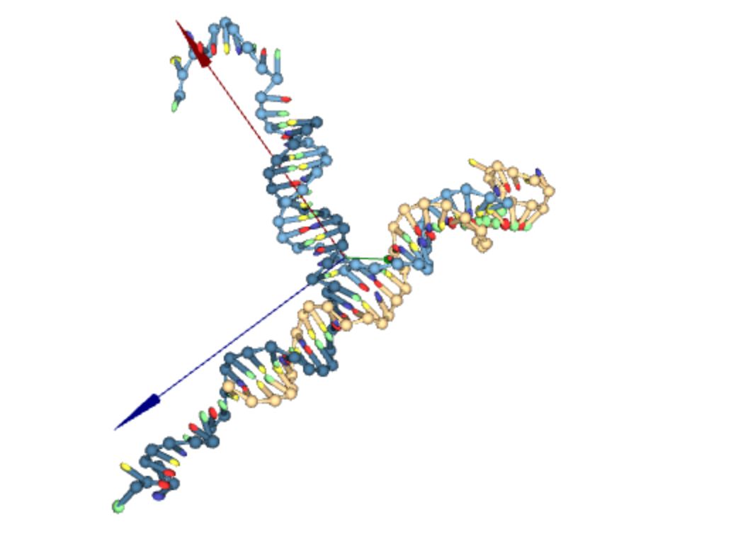
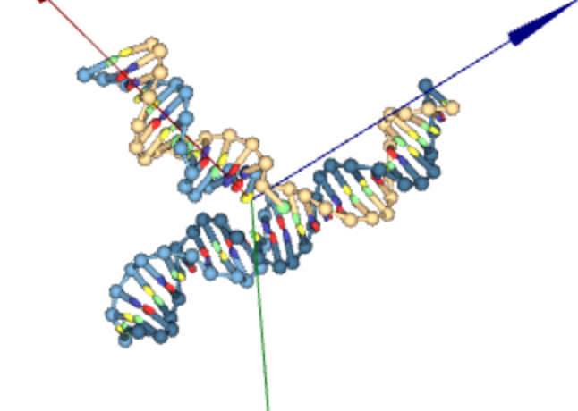
Third task: Relax Y-shape DNA
Screening of temperatures.
Screening of the salt concentration.
Figure 7. Y-shape without sticky ends
Figure 8. Y-shape with sticky ends

Slide 15
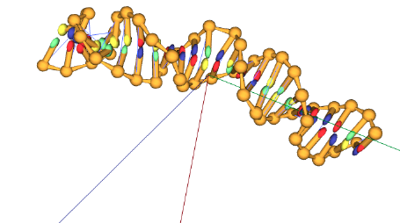
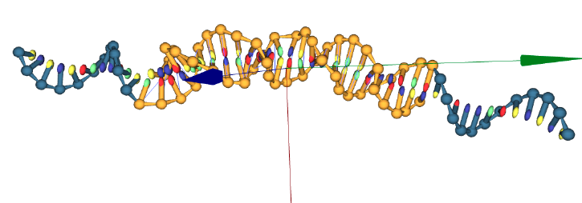
Second task: Relax Linker DNA
Screening of temperatures.
Screening of the salt concentration.
Figure 9. Linker without sticky ends
Figure 10. Linker with sticky ends

Slide 16
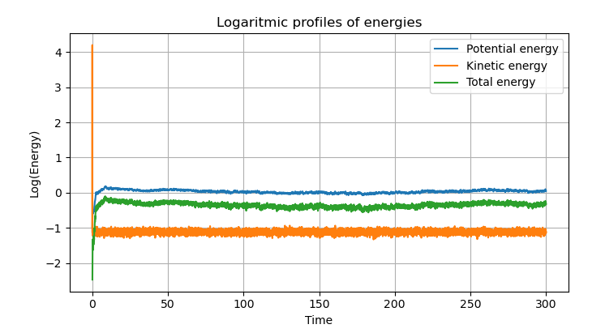
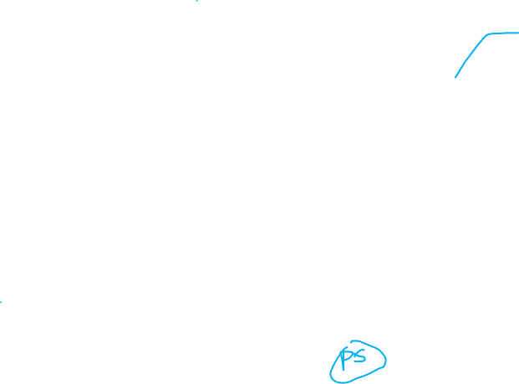
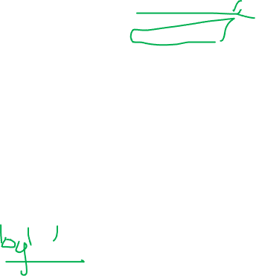
Second task: Relax linker and y-shape
Figure 11. Energy evolution during the relaxation for y-shape at 55 (°C) and 0.15 (mM).

Slide 17
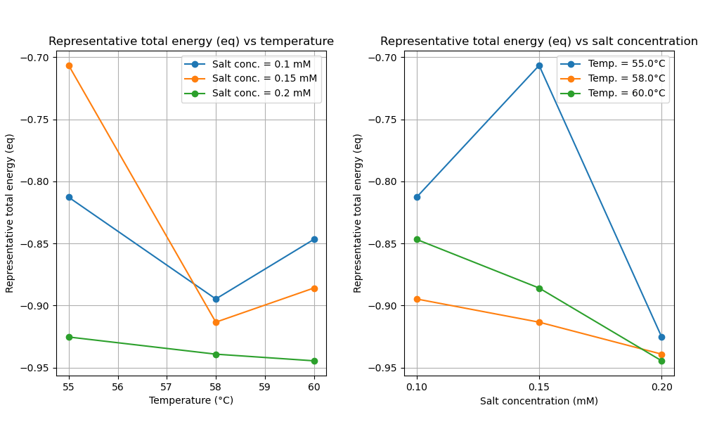
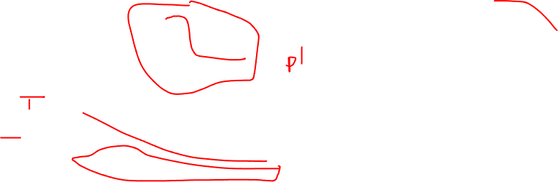
Results
Figure 12. Representative total energy at equilibrium for three different temperatures and three different salt concentration (Y-shape)

Slide 18
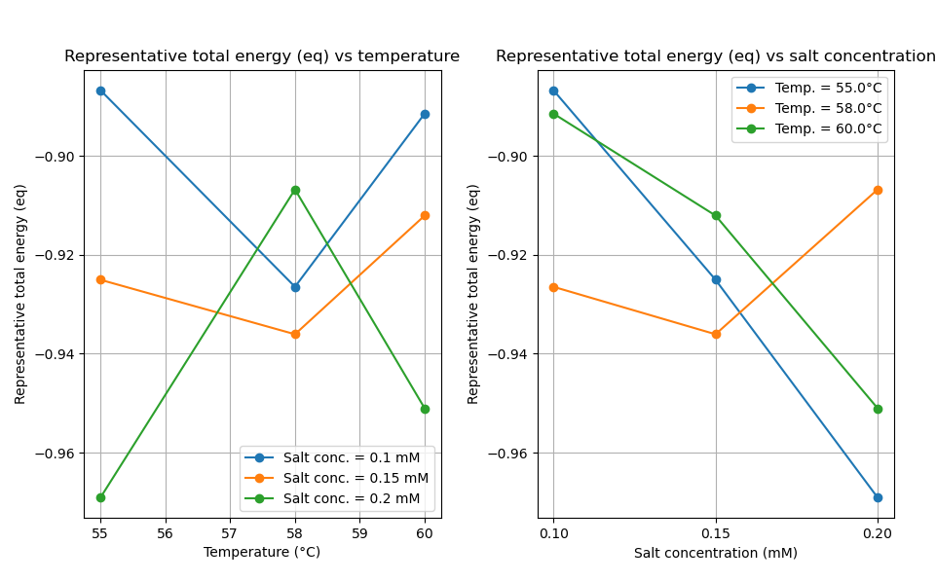
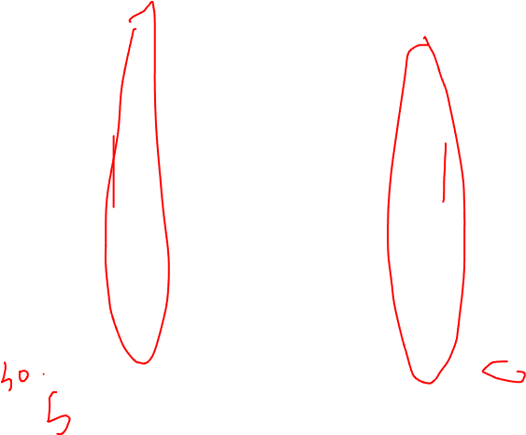
Results
Figure 13. Representative total energy at equilibrium for three different temperatures and three different salt concentration (Linker)

Slide 19
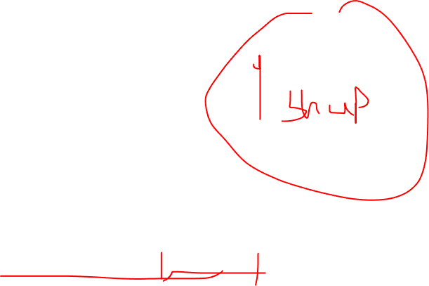
Binding Y-shape and Linkers
Figure . Relaxed binded Y-shape and Linker at 58°C and 0.15 mM

